Slide 1
Practice Quiz- Measurement Skills

Slide 2

1. A student uses a spring scale to measure the weight of an object. The student mistakenly adjusts the zero position of the scale at the 1.0 N mark instead of the 0.0 N mark. All subsequent weights he measures are too small by 1.0 N. This type of error is an example of:
Random Error
Systematic Error
Explain your reasoning:
Since the errors are always consistent (too small) it is systematic.

Slide 3
2. A group three students make repeated measurements of the length of a steel bar. Their measurements are below: 7.7 cm, 7.6 cm, 7.5 cm
Determine their average measurement. Use the range of values to determine the uncertainty.: _____________
According to the manufacturer, the bar is actually 8.2 cm long. How would you describe their set of measurements?
7.6 ± 0.1 cm
Accurate but not precise
Precise but not accurate
Precise and accurate
Neither precise nor accurate
Explain your reasoning:
The values are close together
But the average is not close to the actual value.

Slide 4
3. How many significant digits are there in the following measurements?
4 sig digs
1.005 m ___________
550 km ____________
25.50 s ____________
20 cycles of a pendulum _________
1.3450 L ____________
8.050 x 10² g ____________
2 sig digs
4 sig digs
infinite
5 sig digs
4 sig digs

Slide 5
4. Complete the statements regarding the “weakest link rules” using the terms in red below:
number with the lowest precision (fewest decimal places)
number with the least number of significant digits
1. When multiplying or dividing measurements the ____________________________ is the weakest link.
number with the least number
of significant digits
2. When adding or subtracting measurements the ____________________________ is the weakest link.
number with the lowest precision

Slide 6
5. When finding the volume of a box, a student multiplies the box dimensions below:
5.0 cm x 15.0 cm x 85.0 cm
How should they record their answer?
6.4 x 10 ³ cm ³
6.375 x 10 ³ cm ³
6.37 x 10 ³ cm ³
6.38 x 10 ³ cm ³

Slide 7
6. When finding the perimeter of a yard, a student adds the following length measurements:
10.0 m + 25.0 m + 1.2 x 10 ² m
How should they record their answer?
1.550 x 10 ² m
1.50 x 10 ² m
1.55 x 10 ² m
1.6 x 10 ² m

Slide 8
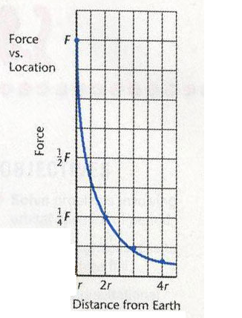
7. The graph below shows a plot of force of gravity versus distance from the Earth’s centre. What type of relationship is shown?
A. linear
B. power
C. inverse
D. root

Slide 9
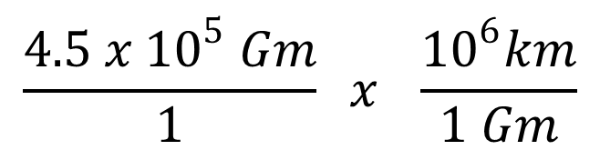
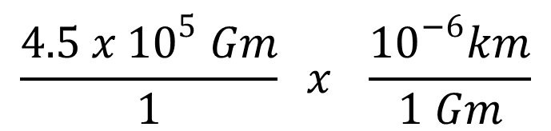
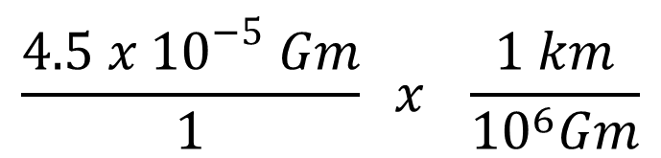
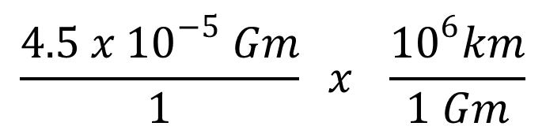
8. Which of the following is the correct statement for completing the following conversion?:
0.000045 Gm = ? kM
A.
$$\frac{4.5 x {10}^{5} Gm}{1} x \frac{{10}^{6}km}{1 Gm}$$
B.
$$\frac{4.5 x {10}^{−5} Gm}{1} x \frac{1 km}{{10}^{6}Gm}$$
C.
$$\frac{4.5 x {10}^{5} Gm}{1} x \frac{{10}^{−6}km}{1 Gm}$$
$$\frac{4.5 x {10}^{−5} Gm}{1} x \frac{{10}^{6}km}{1 Gm}$$
D.

Slide 10
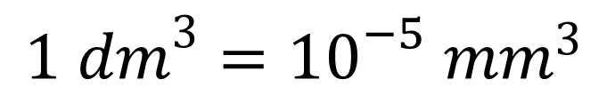
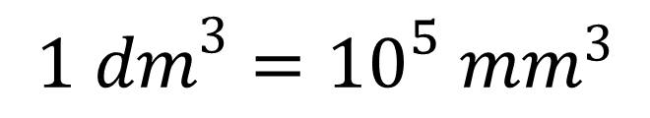
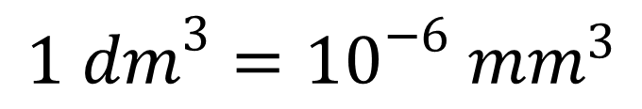
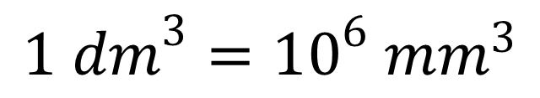
9. Which of the following is the correct conversion factor for completing the following conversion?
180 000 mm³ = ? dm³
A.
$$1 {dm}^{3}={10}^{6} {mm}^{3}$$
B.
$$1 {dm}^{3}={10}^{−6} {mm}^{3}$$
C.
$$1 {dm}^{3}={10}^{5} {mm}^{3}$$
D.
$$1 {dm}^{3}={10}^{−5} {mm}^{3}$$

Slide 11
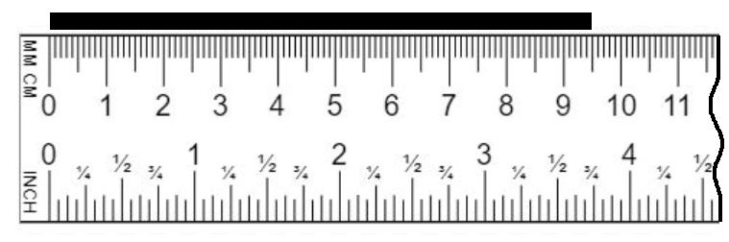
Record your measurement of the black line shown below using the given ruler.
Include your estimated uncertainty.
Measurement:
Possible answers:
9.5 ± 0.1 cm, 9.4 ± 0.1 cm, 9.45 ± 0.05 cm
Explain your reasoning:
If I can estimate to the nearest millimeter I record the measurement as 9.5 ± 0.1 cm.
If can estimate between the smallest division then I record 9.45 ± 0.05 cm .

Slide 12
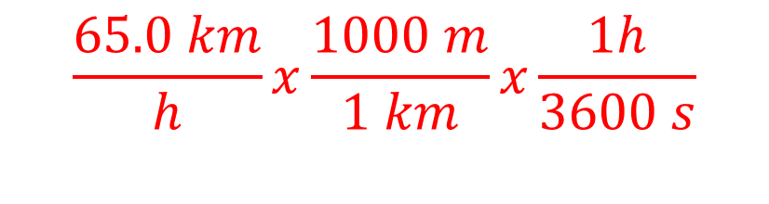

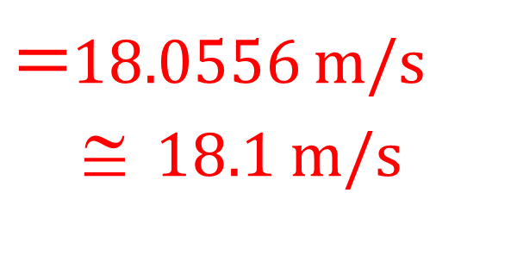

12. Complete the following conversions. Show your work!
a) 154,000 kg = ? Gg b) 65.0 km/h = ? m/s
C.F: 1 km = 1000 m
1 h = 3600 s
C.F: 1 Gg = 10⁶ kg
$$\frac{154,000 kg}{1}x\frac{1 Gg}{{10}^{6}kg}$$
$$=154,000 x {10}^{−6}Gg$$
$$=1.54 x {10}^{5}x {10}^{−6}Gg$$
= 0.154 Gg
$$\frac{65.0 km}{h}x\frac{1000 m}{1 km}x\frac{1h}{3600 s}$$
$$=\frac{65.0 x 1000 m}{3600 s}$$
$=$18.0556 m/s
$$ 18.1 m/s

